Slide 1

Reusing Your Analog IPs Successfully For Tapeouts

Slide 2





About us
Pioneer & market leaders in SoC design & IP management solutions for the semiconductor industry
Founded in 1997
Headquartered in Fremont, CA
Worldwide offices
USA, Europe, Japan, Korea, China, Taiwan, Israel & India
24x7 worldwide support
© 2018 ClioSoft Inc.
2
Notes:
x250

Slide 3

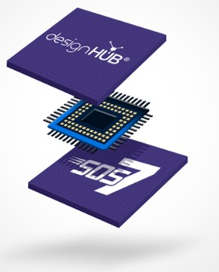
Our products
designHUB – Ecosystem for IP reuse and project collaboration
Visual Design Diff – Compares versions of schematics or layouts
SOS7 – Design management built for Analog, Mixed Signal, Digital and RF
© 2018 ClioSoft Inc.
3

Slide 4




Why is analog IP reuse becoming important?
Integration of mixed-signal blocks has grown considerably in the past decade
Tight timelines & increased design complexity
Need to redesign for new nodes
But what is limiting IP reuse in the company?
Lack of visibility of IPs across the company
IPs & design collateral gets trapped in artificial silos - Business units, physical locations, organizational structures
Getting support for internal IPs
Difficult to identify IP developer and obtain desired support
Lack of available documentation
No information on where the specs are located or why a certain decision was made
No standardization and classification of IP metadata
No consistency about IP attributes makes it hard to search for the right IP
Notes:
Over the past few years there has been an interest toward cheap, low power portable electronics, which is driving the semiconductor industry to move toward more and more integration of functional blocks over a single IC in what is known as SoC design.
The complexity of SoC designs nowadays is ever increasing and has resulted in more integration of mixed-signal blocks over a single IC.
Driven also by the need to be more powerful, semiconductor manufacturers continue to innovate technologies towards smaller and smaller transistor feature sizes (for example from 0.25um to 0.18um to 0.13um). As a result, there is an increasing need in re-designing functioning mixed signal designs for new technology processes.
Digital IP reuse is a well- established world thanks to the advance in the well-defined and automated digital flow available nowadays through different CAD companies. The analog domain on the other hand is still suffering from the lack of automation, which resulted in the analog IP portion being manually redesigned each time an SoC is migrated from a technology to another.

Slide 5

Questions … Questions …
Do we have the design specification for this IP?
What testbenches were used to test the design?
Which designs are using this IP?
Are there any open issues for the IP?
Who is the author of the IP?
What is the PDK for this IP?
Notes:
Designers need to have access to a number of requirements to understand the conditions under which they can expect the IP to work.

Slide 6






I want this IP …
Where can I find the IP design data?
Multiple unconnected sources of information
Issue tracking system
Design data management systems
Emails
Notes
Meeting minutes
Spread across multiple applications and physical locations

Slide 7

What is the solution?
An IP reuse eco-system where designers can browse, read IP reviews, ask questions, select the most suitable IP and publish with ease
MUST HAVES
Ability to browse, compare, qualify, download & upload IPs with ease across the enterprise
Provide multiple levels of security for IP access & usage
Active knowledgebase for all design objects to reduce IP support overhead
Bridge the gap between IP developer and user
Manage 3rd party IP licensing and maintenance
Works with existing data management solutions

Slide 8




User centric collaborative design platform
IP Reuse Ecosystem
Unified Dashboard & Hub
Create, share and reuse IP
Track IP usage
Notify users on issues and fixes
Home page for designers
News feed of of all design activity, status & issues
Capture discussion & conclusions
Crowdsourcing
Share your insights
Use & participate in a growing knowledgebase
Create interest groups to share expertise
Notes:
the primary reason IP-reuse strategies are not widely in place today is the extra effort required to package all the preceding requirements into a reusable form. Properly documenting everything required to pass the design to a different designer depletes precious design time. Therefore, to make a reuse strategy effective, you must minimize the extra effort to document and package the design. The most effective method is, of course, to capture and package the design process as it transpires, along with data for use in design reviews. A reuse strategy requiring minimal effort is, of course, more likely to be adopted.

Slide 9
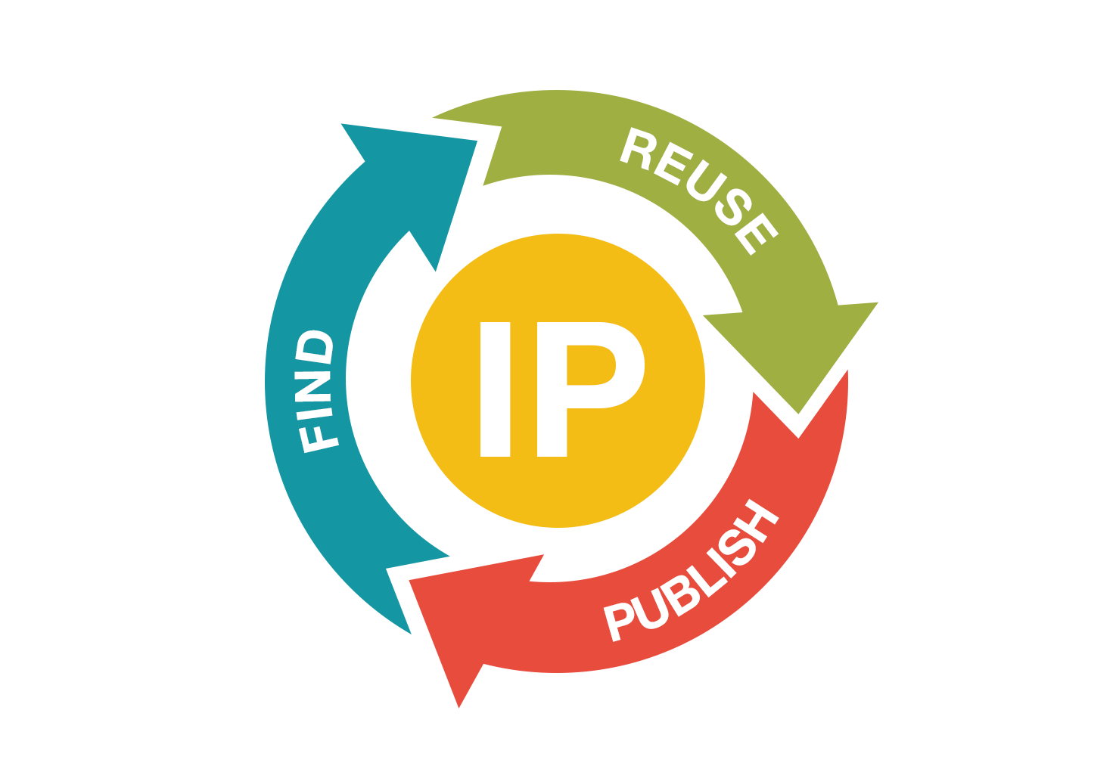
IP reuse eco-system
Reuse
Track IP issues, defects and their resolutions
Dedicated forum & knowledge base
Notification of new issues & releases
Find
Web based catalog accessible across the enterprise
Search and compare
Get IP details and gauge quality
Publish
Publish internal and 3rd party IP
Track IP usage and dependencies
Feedback to incentivize sharing
Notes:
No accolades – forum for feedback

Slide 10






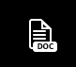



Unified project dashboard & hub
Collaborative SoC development
Choose IP
Access controls
Deliver in time
Setup dashboard
Knowledge base
Discussions
Manage risks
Sync team
Latest design specs
Manage schedules
Notifications and Alerts
10

Slide 11
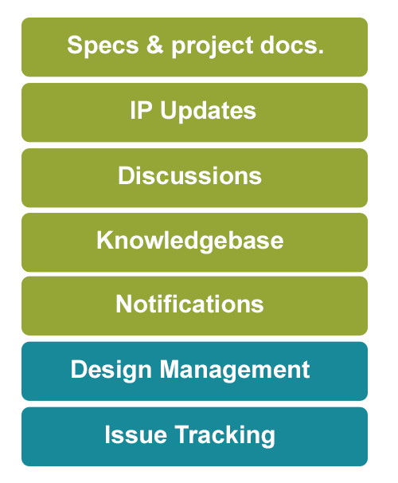

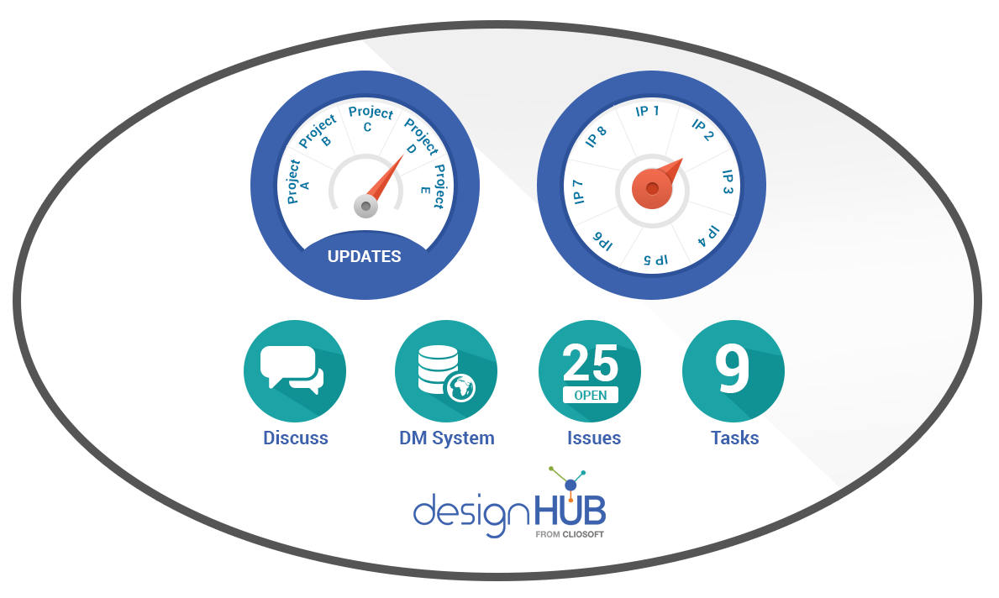
Aggregate all project information
Unified dashboard for all project data
Notes:
Knowledge base

Slide 12
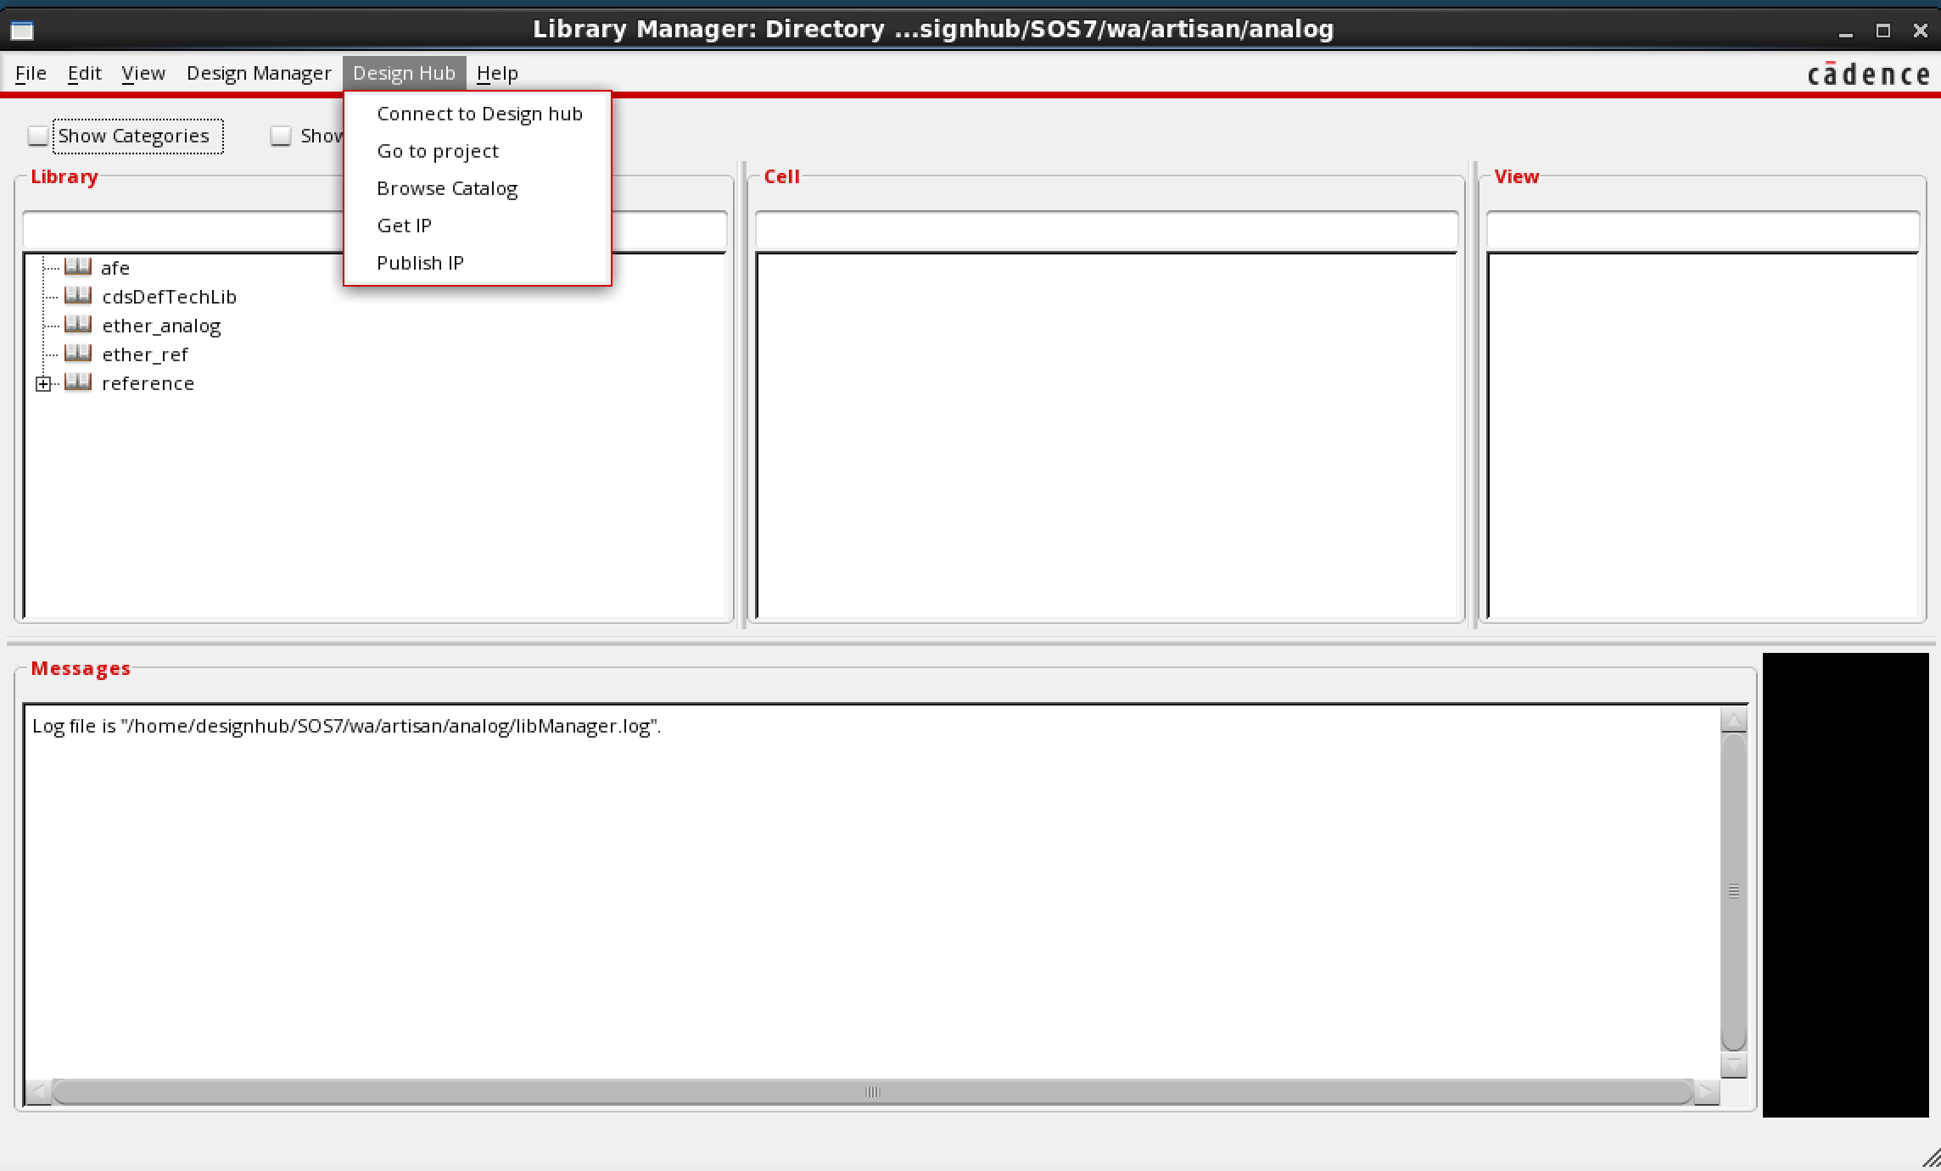
Access designHUB from Cadence Virtuoso

Slide 13
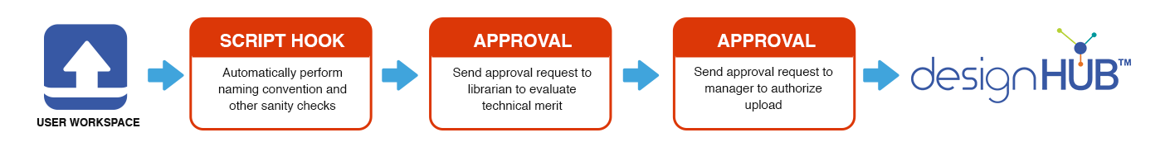
Publish IP from Cadence Virtuoso
Publish an entire library
OR
Publish a cell hierarchy

Slide 14
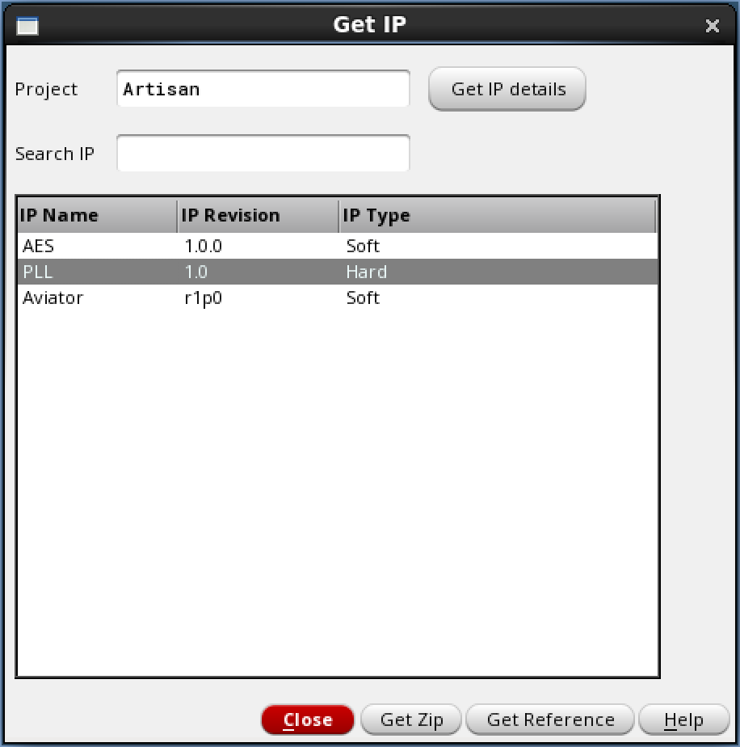

Get IP from Cadence Virtuoso
Browse, search and compare IPs
Select IP
Request for approval
Get the approved IP into user workarea
14

Slide 15
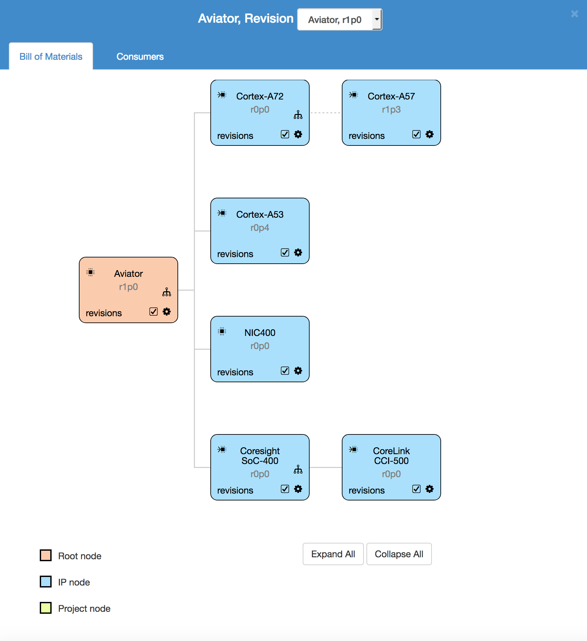
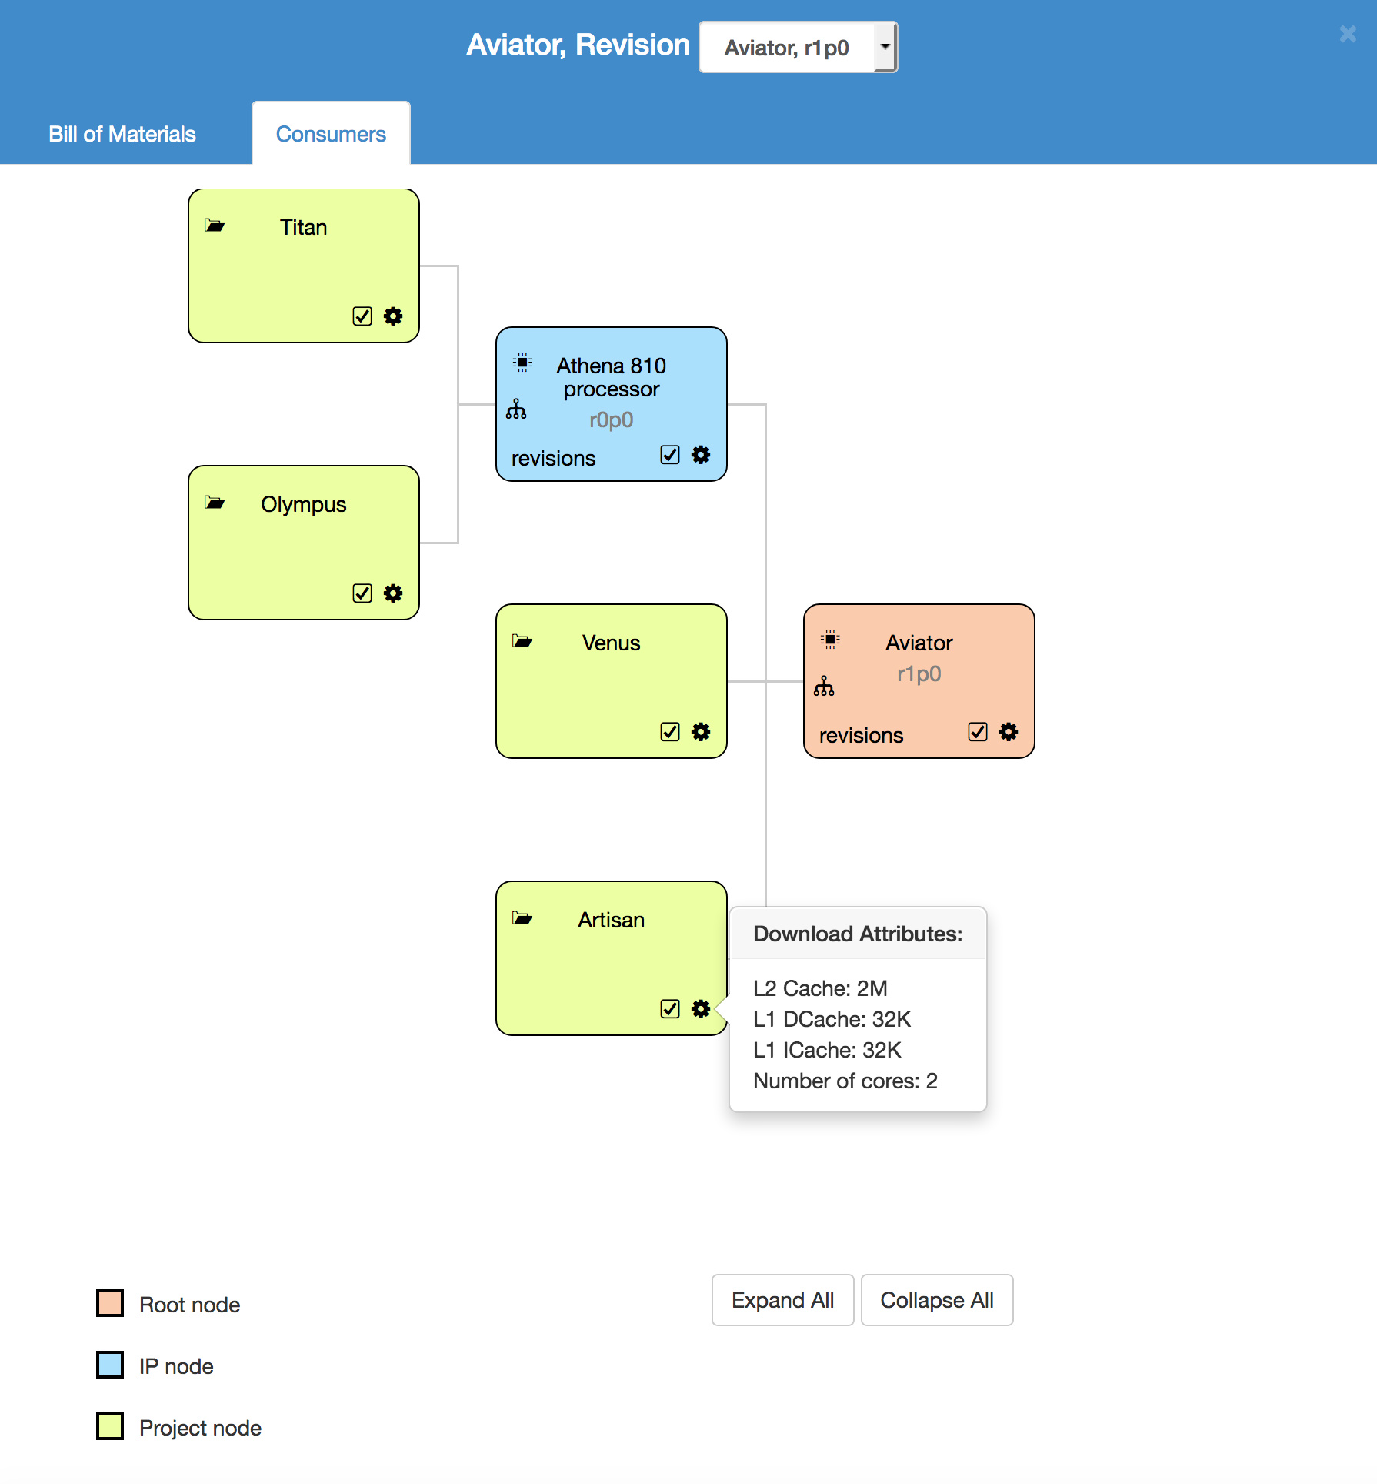
Dependency tracking
Bill of Materials
Consumers

Slide 16
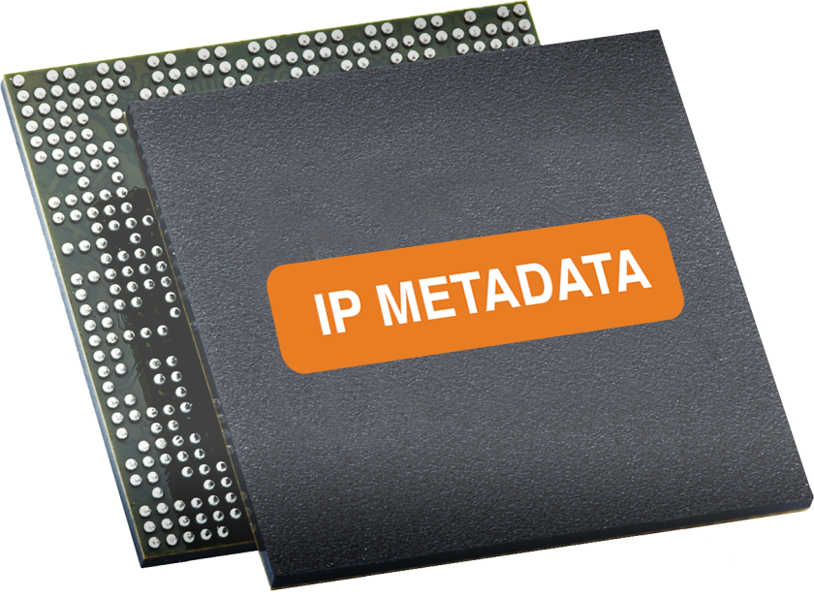

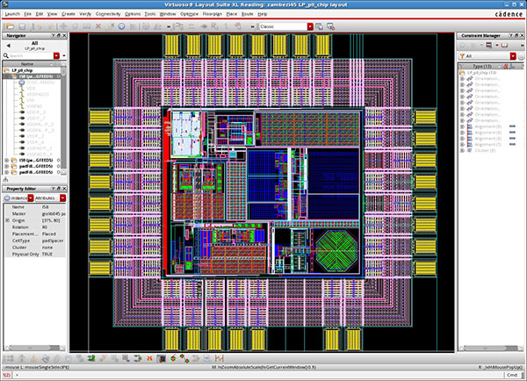
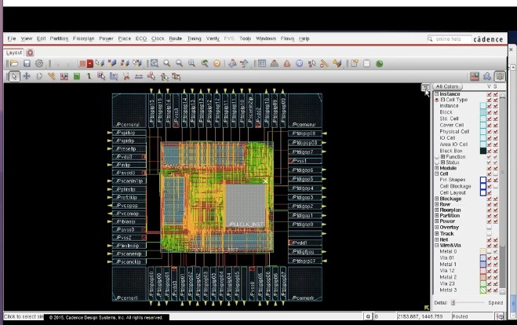





Store design data where you want
Multiple ways to store design data – any DM software, within designHUB or on network storage
Works with any data management software – SOS, Git, Subversion, Perforce
DATA
DATA
Single portal to Access all IPs & designs throughout the enterprise irrespective of where the data is stored
NAS/SAN

Slide 17
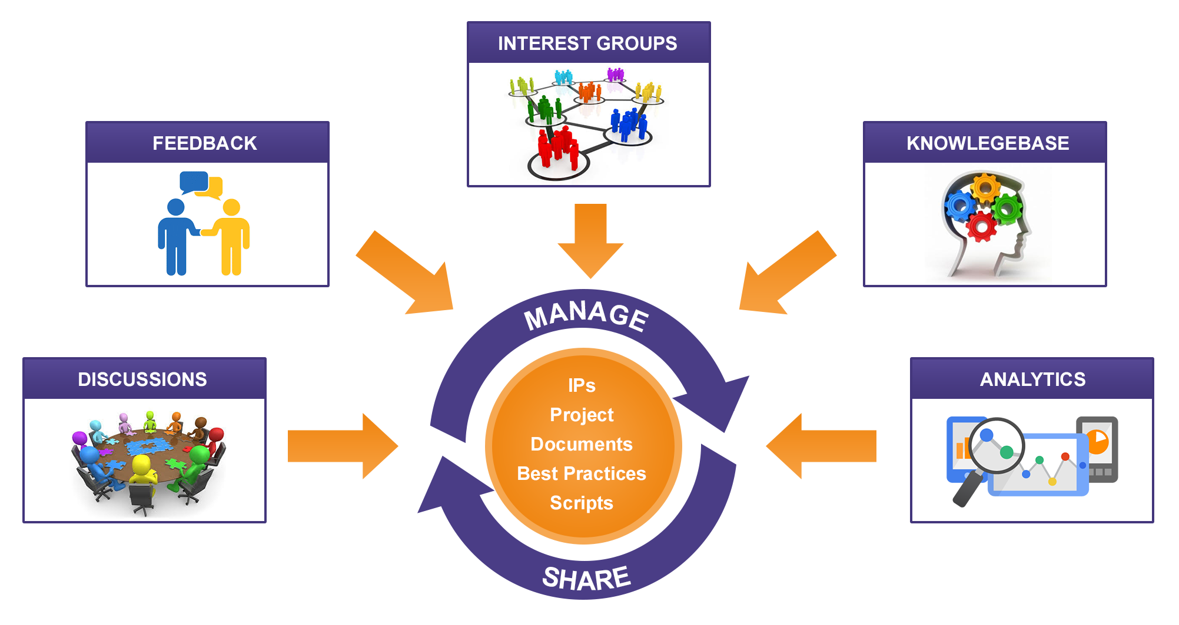
Enterprise crowdsourcing platform

Slide 18

Create a culture of sharing
Unleash the intelligence in your enterprise

